Slide 1



Powered by

Slide 2
Basic workflow
Load your xPONENT (.xlsx) and/or multi-tab BPM (.xlsx) files into the app
Indicating background and specific controls in xPONENT protocol aids user in plot generation
BPM files must be saved in multiple-analyte layout and have tabs for “FI”, “FI – Bkgd”, and “Bead Count” or they will not be accepted
Set parameters in the app’s modules
Interact with your data in the modules
Download outputs

Slide 3
Upload Module

Slide 4
3 options for uploading your run data
Upload only your xPONENT (.csv) and/or BPM (.xlsx) instrument files
Upload merged datasets from previous shinyMBA sessions
Use “raw_data.csv” acquired from the Downloads module
Append your xPONENT/BPM files to a merged datasets from a previous shinyMBA session

Slide 5
Upload only your xPONENT (.csv) and/or BPM (.xlsx) instrument files

Slide 6
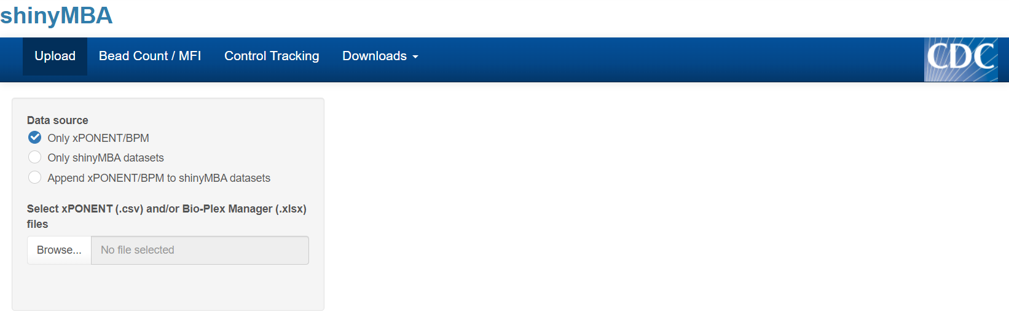
Load xPONENT (.csv) and/or BPM (.xlsx) files into the app
Click the “Upload” tab
Under “Data source”, select “Only xPONENT/BPM”
Click “Browse…” to open the file explorer

Slide 7
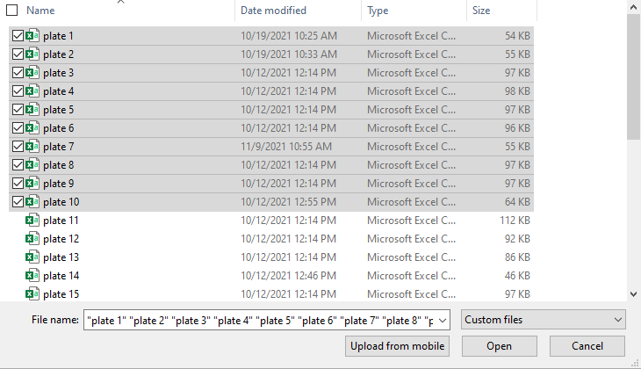
Load xPONENT (.csv) and/or BPM (.xlsx) files into the app
Click the “Upload” tab
Under “Data source”, select “Only xPONENT/BPM”
Click “Browse…” to open the file explorer
Select the xPONENT and/or BPM files you want to load (multiple can be loaded at once) and click “Open”

Slide 8
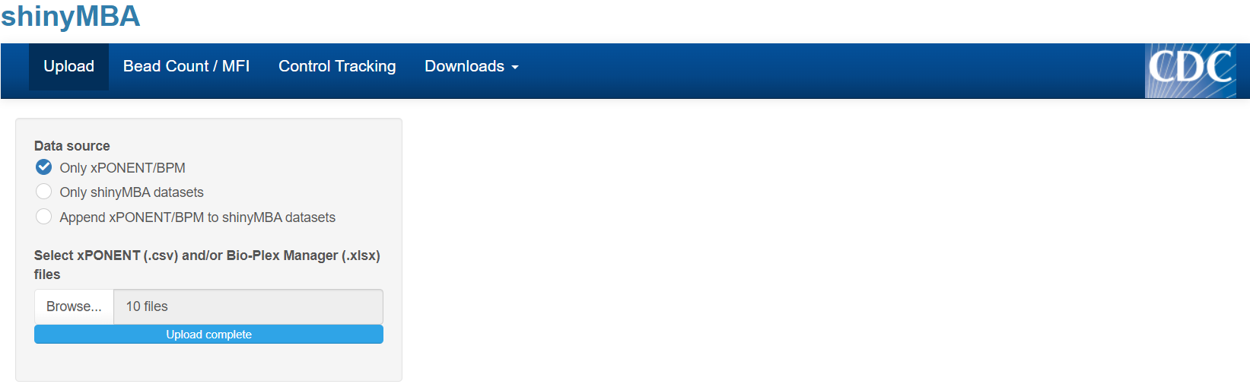
Load xPONENT (.csv) and/or BPM (.xlsx) files into the app
Click the “Upload” tab
Under “Data source”, select “Only xPONENT/BPM”
Click “Browse…” to open the file explorer
Select the xPONENT and/or BPM files you want to load (multiple can be loaded at once) and click “Open”
Wait for the progress bar to state “Upload complete”
Begin using the app!

Slide 9
Upload only merged datasets from previous shinyMBA sessions

Slide 10
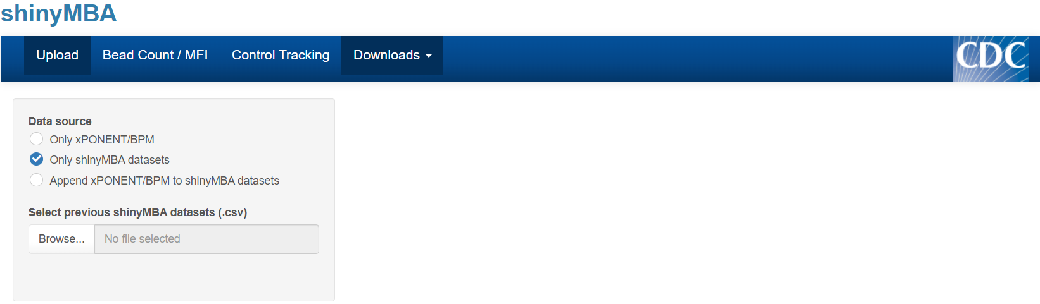
Load datasets from previous shinyMBA session
Click the “Upload” tab
Under “Data source”, select “Only shinyMBA datasets”
Click “Browse…” to open the file explorer

Slide 11
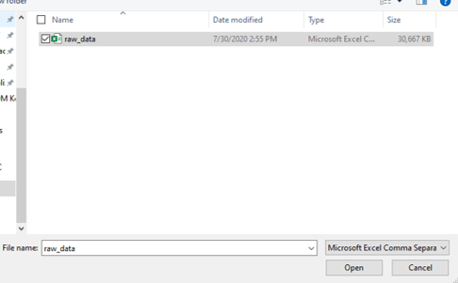
Load merged datasets from previous shinyMBA session
Click the “Upload” tab
Under “Data source”, select “Only shinyMBA datasets”
Click “Browse…” to open the file explorer
Select the merged data files you want to load (multiple can be loaded at once) and click “Open”

Slide 12
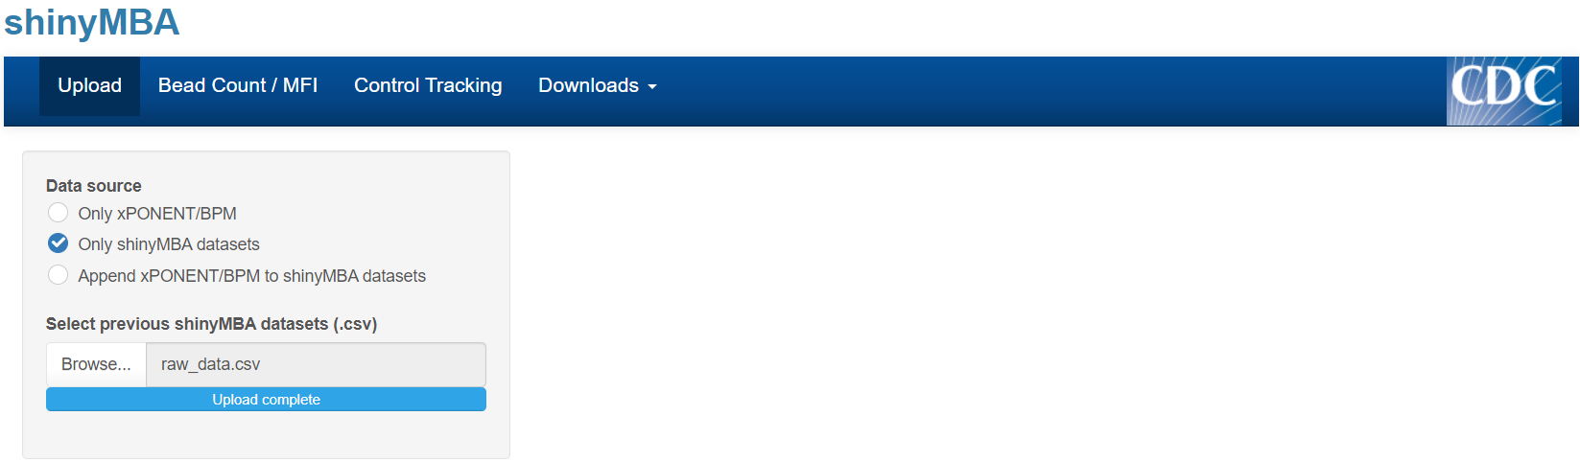
Load merged datasets from previous shinyMBA session
Click the “Upload” tab
Under “Data source”, select “Only shinyMBA datasets”
Click “Browse…” to open the file explorer
Select the merged data files you want to load (multiple can be loaded at once) and click “Open”
Wait for the progress bar to state “Upload complete”
Begin using the app!

Slide 13
Append your xPONENT/BPM files to a merged datasets from a previous shinyMBA session

Slide 14
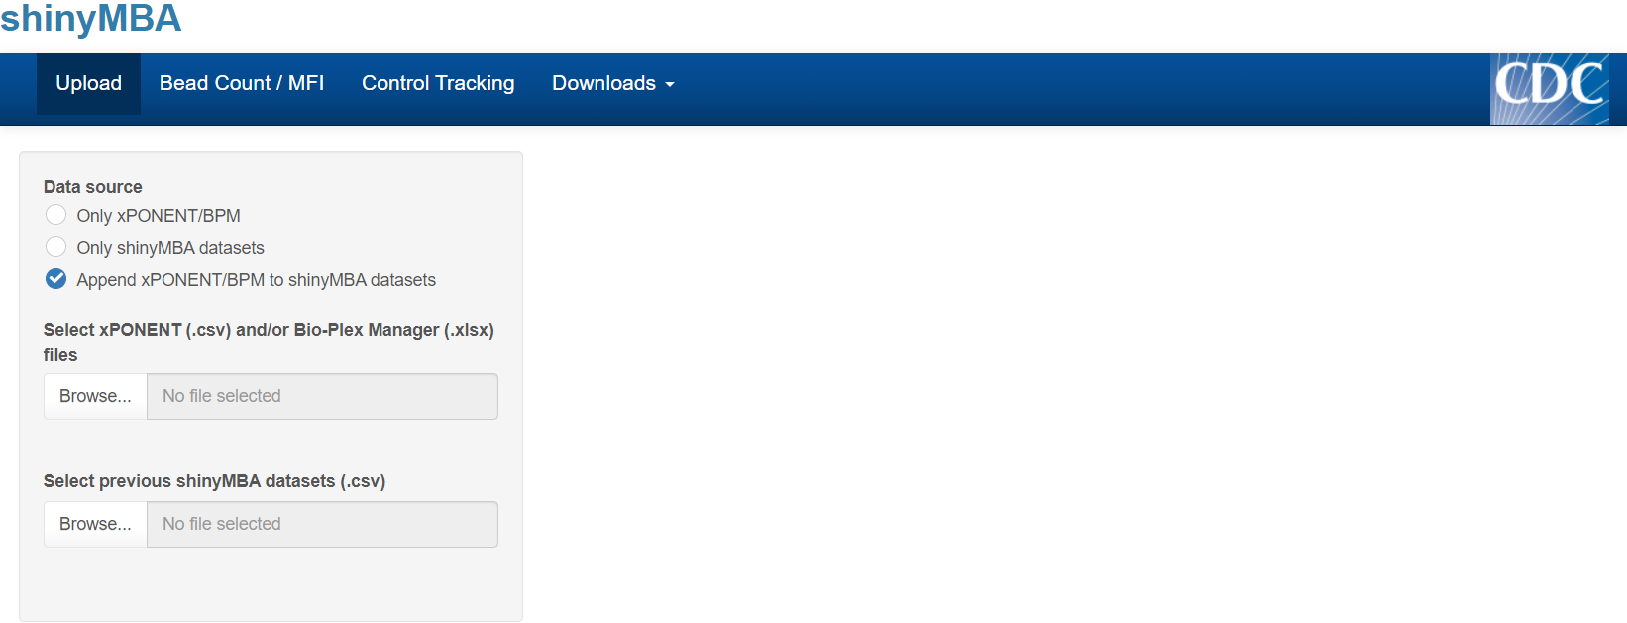
Click the “Upload” tab
Under “Data source”, select “Only xPONENT/BPM”
Load xPONENT (.csv) and/or BPM (.xlsx) files into the app
Click “Browse…” to open the file explorer

Slide 15
Click the “Upload” tab
Under “Data source”, select “Only xPONENT/BPM”
Load xPONENT (.csv) and/or BPM (.xlsx) files into the app
Click “Browse…” to open the file explorer
Select the xPONENT and/or BPM files you want to load (multiple can be loaded at once) and click “Open”

Slide 16
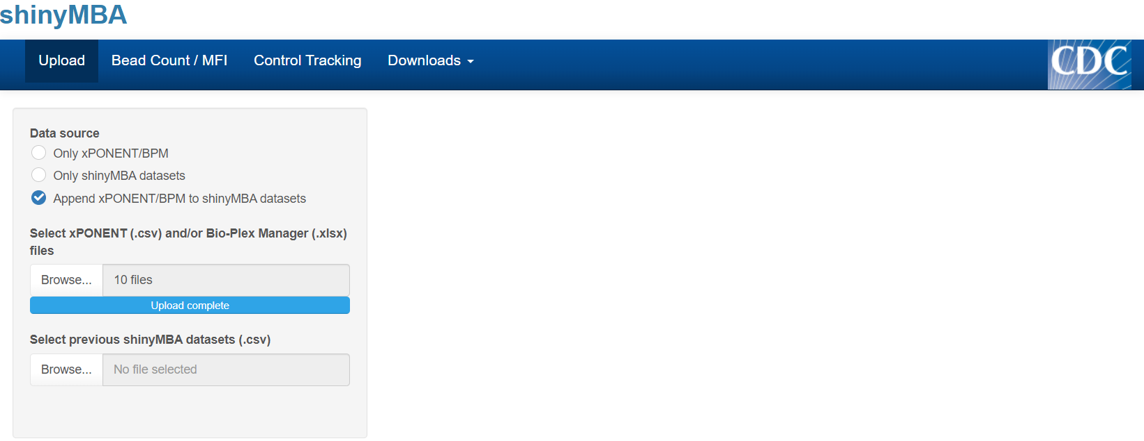
Click the “Upload” tab
Under “Data source”, select “Only xPONENT/BPM”
Load xPONENT (.csv) and/or BPM (.xlsx) files into the app
Click “Browse…” to open the file explorer
Select the xPONENT and/or BPM files you want to load (multiple can be loaded at once) and click “Open”
Load merged datasets from previous shinyMBA session
Click “Browse…” to open the file explorer

Slide 17
Click the “Upload” tab
Under “Data source”, select “Only xPONENT/BPM”
Load xPONENT (.csv) and/or BPM (.xlsx) files into the app
Click “Browse…” to open the file explorer
Select the xPONENT and/or BPM files you want to load (multiple can be loaded at once) and click “Open”
Load merged datasets from previous shinyMBA session
Click “Browse…” to open the file explorer
Select the merged data files you want to load (multiple can be loaded at once) and click “Open”

Slide 18
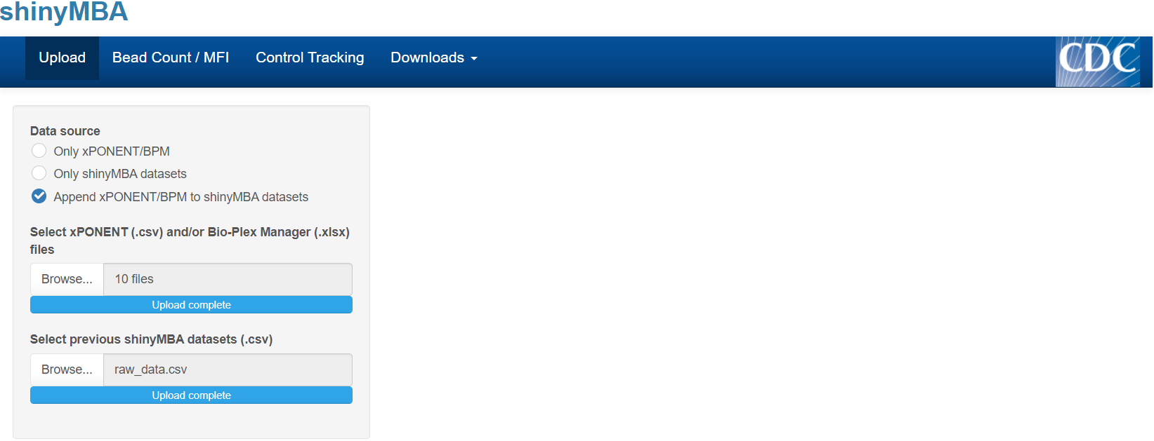
Click the “Upload” tab
Under “Data source”, select “Only xPONENT/BPM”
Load xPONENT (.csv) and/or BPM (.xlsx) files into the app
Click “Browse…” to open the file explorer
Select the xPONENT and/or BPM files you want to load (multiple can be loaded at once) and click “Open”
Load merged datasets from previous shinyMBA session
Click “Browse…” to open the file explorer
Select the merged data files you want to load (multiple can be loaded at once) and click “Open”
Wait for the progress bars to state “Upload complete”
Begin using the app!

Slide 19
Bead Count/MFI Module
Bead count component

Slide 20

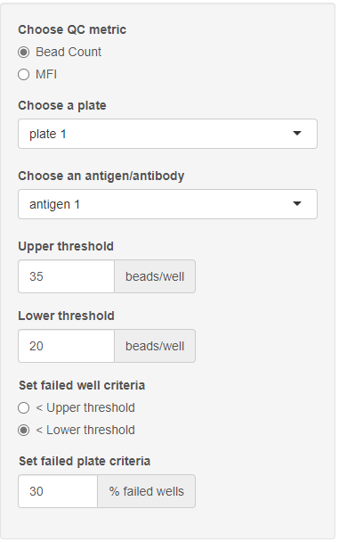
Bead Count QC: setting parameters
Click the “Bead Count / MFI” tab
Under “Choose QC metric” select “Bead Count”
Under “Choose a plate” and “Choose an antigen/antibody”, select which batch and antigen/antibody combination you’d like the app to display.
Inform the app of your bead count upper and lower thresholds
Set how the app determines failed wells
Bead counts under the upper threshold or under the lower threshold
Set how the app determines failed plates
% of wells with bead counts under the upper or lower threshold

Slide 21
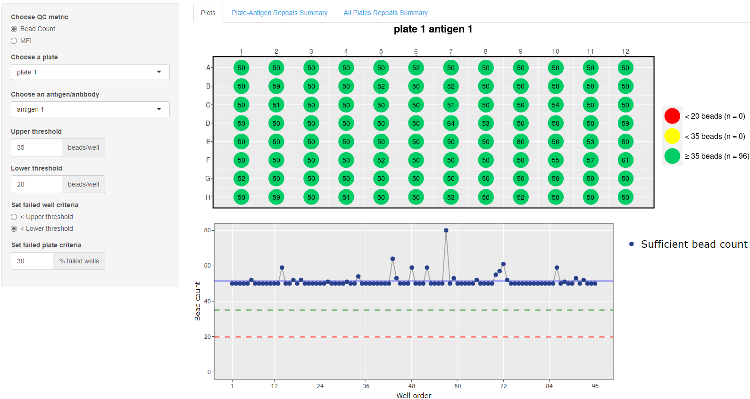

Slide 22
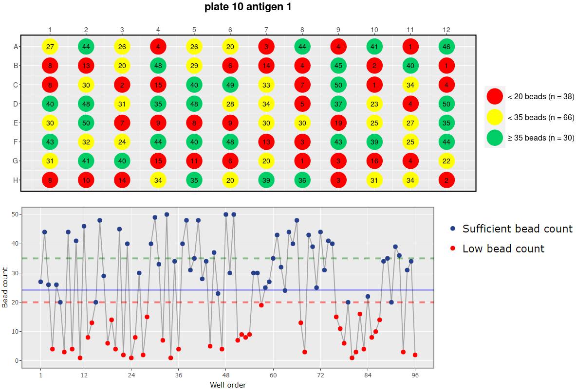
Problematic bead count example

Slide 23
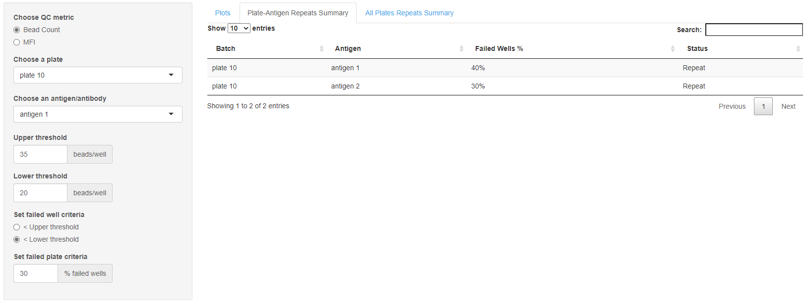
“Plate-Antigen Repeats Summary” tab contains an interactive data table of failed antigens for each batch.

Slide 24
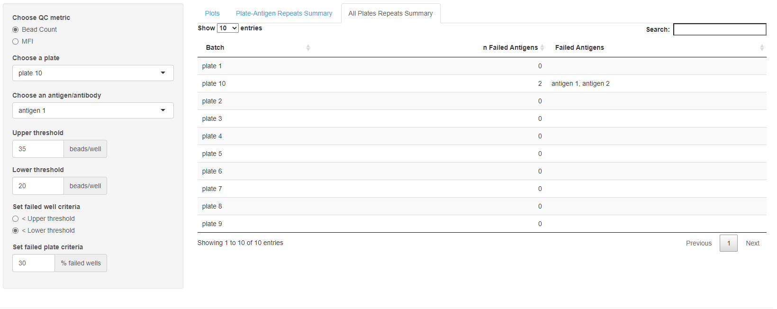
“All Plates Repeats Summary” tab contains a condensed interactive data table of failed antigens for each batch.

Slide 25
Bead Count/MFI Module
MFI component

Slide 26
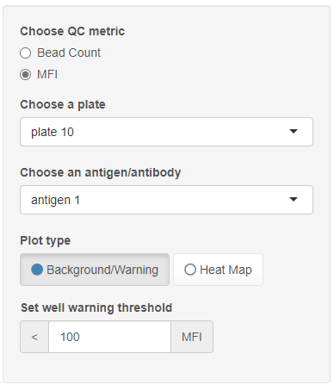
MFI QC: setting parameters
Click the “Bead Count / MFI” tab
Under “Choose QC metric” select “MFI”
Under “Choose a plate” and “Choose an antigen/antibody”, select which batch and antigen/antibody combination you’d like the app to display.
Choose which plot to display
Set the MFI warning threshold
Any wells with MFI under this value are flagged yellow

Slide 27
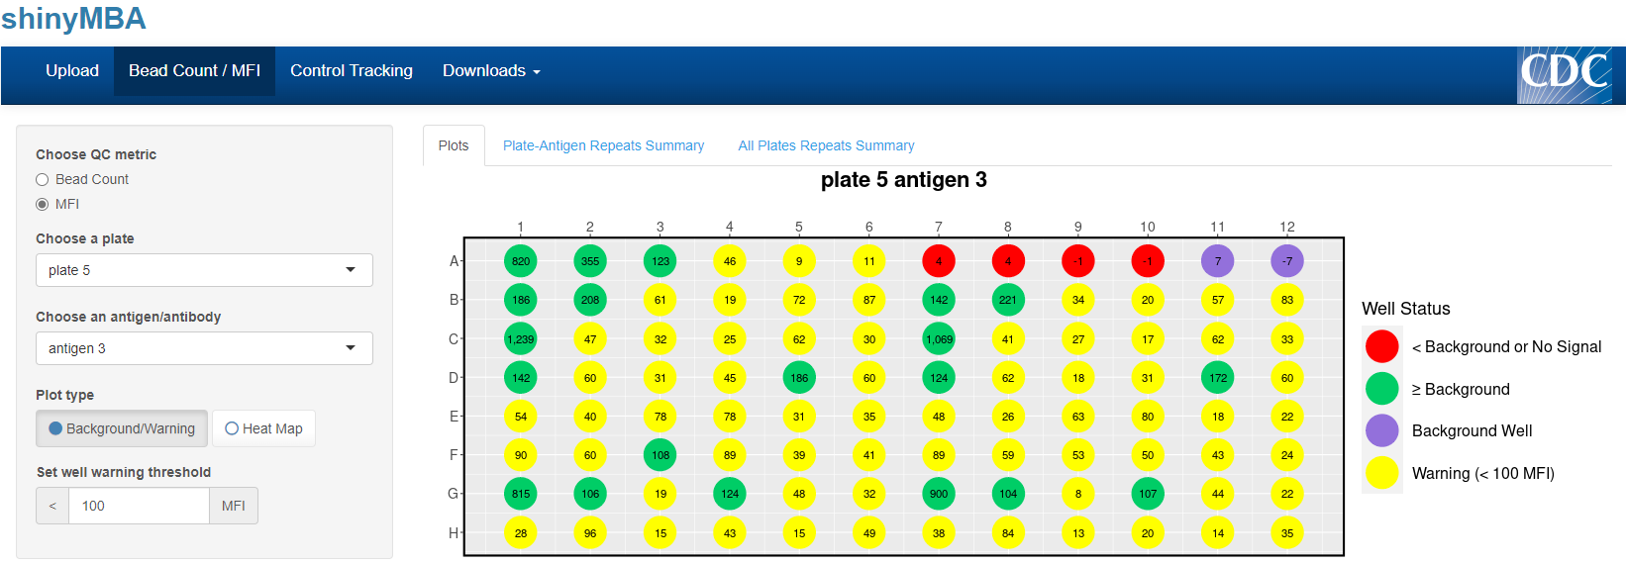
“Plots” tab displays a single 96-well plate plot with four color groups:
PURPLE: background well(s)
RED: MFI ≤ background MFI
YELLOW: MFI > background MFI, but < MFI warning threshold
GREEN: MFI > MFI warning threshold
“Plate-Antigen Repeats Summary” and “All Plates Repeats Summary” tabs do not display anything for MFI

Slide 28
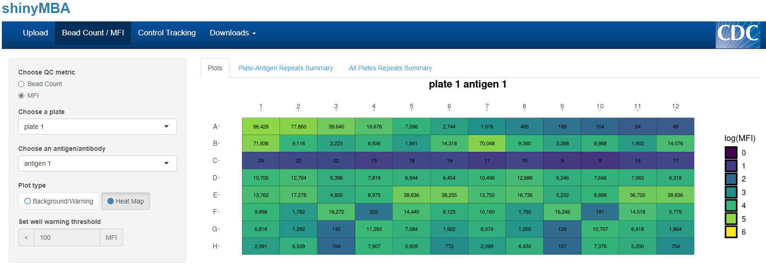
“Heat Map” displays a single 96-well plate plot with a color scale for log-transformed MFI and text displays for MFI.
MFI warning threshold is not applicable for this plot.
“Plate-Antigen Repeats Summary” and “All Plates Repeats Summary” tabs do not display anything for MFI.

Slide 29
Control Tracking Module
xPONENT/BPM data source

Slide 30

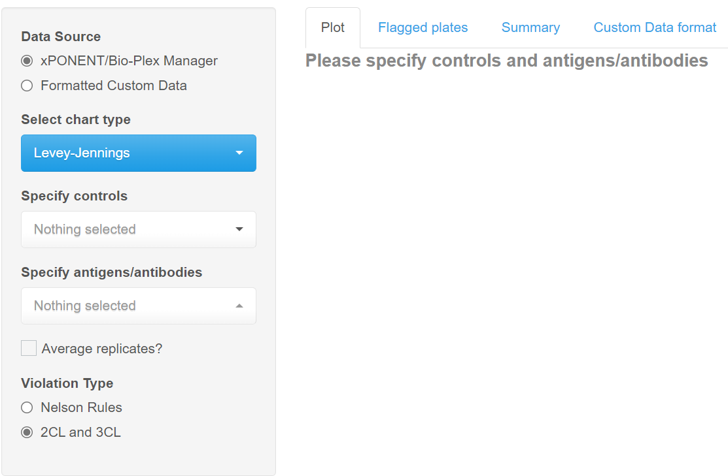
Control Tracking: xPONENT/BPM data
Click the “Control Tracking” tab
Under “Data Source” select “xPONENT/Bio-Plex Manager” to begin loading your data
Data may take several minutes to load

Slide 31
Control Tracking: xPONENT/BPM data
Click the “Control Tracking” tab
Under “Data Source” select “xPONENT/Bio-Plex Manager” to begin loading your data
This may take several minutes
Under “Select chart type”, select which process control chart you want to use.
Levey-Jennings, Shewhart, or Moving Range

Slide 32
Control Tracking: xPONENT/BPM data
Click the “Control Tracking” tab
Under “Data Source” select “xPONENT/Bio-Plex Manager” to begin loading your data
This may take several minutes
Under “Select chart type”, select which process control chart you want to use
Levey-Jennings, Shewhart, or Moving Range.
Under “Specify your controls” and “Specify antigens/antibodies”, select the sample ID’s that correspond to your controls and which antigens/antibodies your controls are relevant for

Slide 33
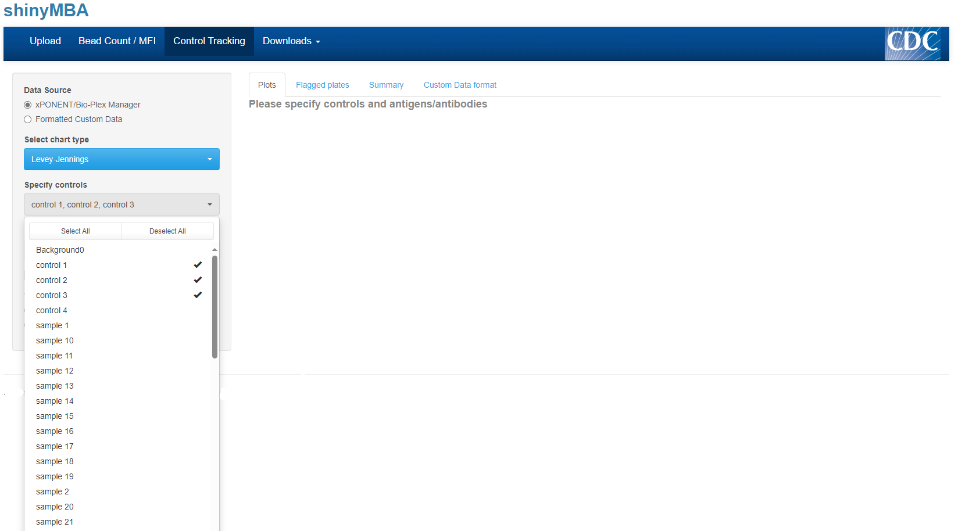
Control Tracking: xPONENT/BPM data
Click the “Control Tracking” tab
Under “Data Source” select “xPONENT/Bio-Plex Manager” to begin loading your data
This may take several minutes
Under “Select chart type”, select which process control chart you want to use
Levey-Jennings, Shewhart, or Moving Range.
Under “Specify your controls” and “Specify antigens/antibodies”, select the sample ID’s that correspond to your controls and which antigens/antibodies your controls are relevant for

Slide 34
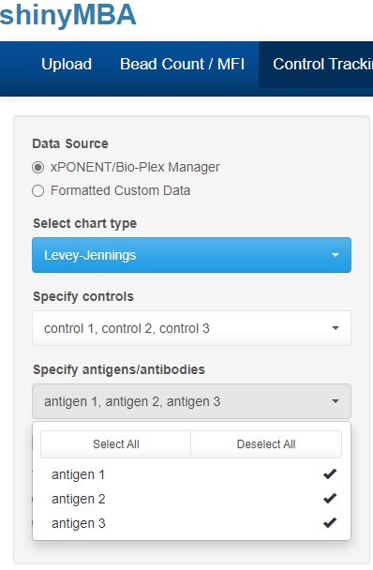
Control Tracking: xPONENT/BPM data
Click the “Control Tracking” tab
Under “Data Source” select “xPONENT/Bio-Plex Manager” to begin loading your data
This may take several minutes
Under “Select chart type”, select which process control chart you want to use
Levey-Jennings, Shewhart, or Moving Range.
Under “Specify your controls” and “Specify antigens/antibodies”, select the sample ID’s that correspond to your controls and which antigens/antibodies your controls are relevant for

Slide 35
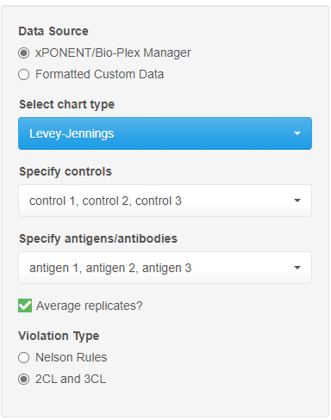
Control Tracking: xPONENT/BPM data
Click the “Control Tracking” tab
Under “Data Source” select “xPONENT/Bio-Plex Manager” to begin loading your data
This may take several minutes
Under “Select chart type”, select which process control chart you want to use
Levey-Jennings, Shewhart, or Moving Range.
Under “Specify your controls” and “Specify antigens/antibodies”, select the sample ID’s that correspond to your controls and which antigens/antibodies your controls are relevant for
Check “Average replicates?” if control replicates for each plate should be averaged before conducting LJ analyses
Under “Violation Type”, choose the criteria for out of control data points
Nelson Rules: set of 8 rules commonly used in control charts
2CL and 3CL: flags points falling outside of the 2σ or 3σ confidence limits

Slide 36
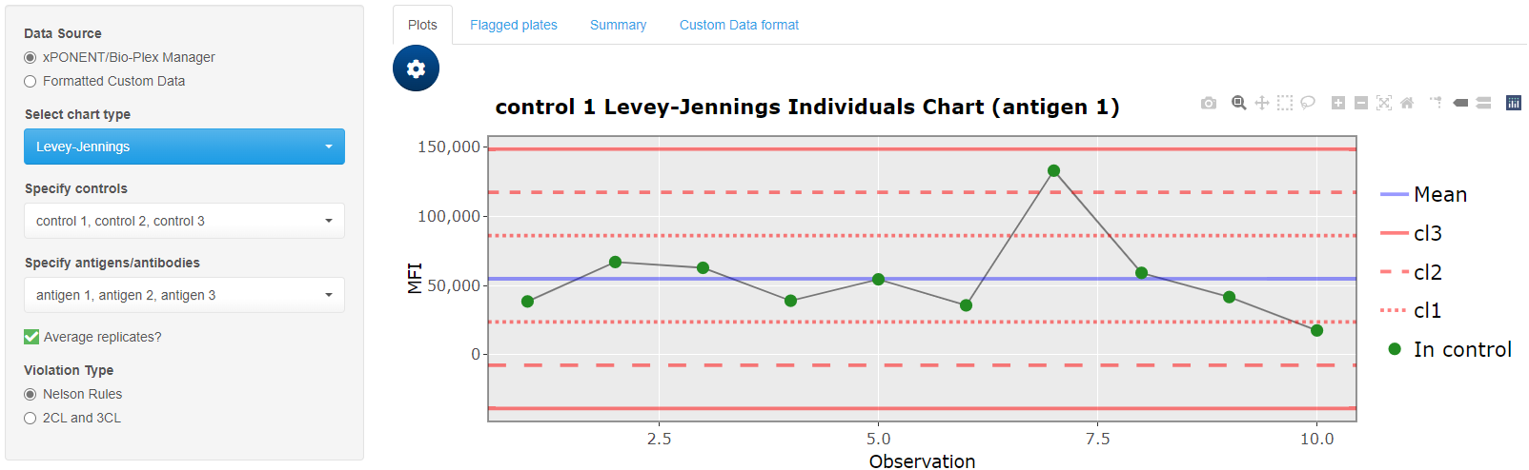
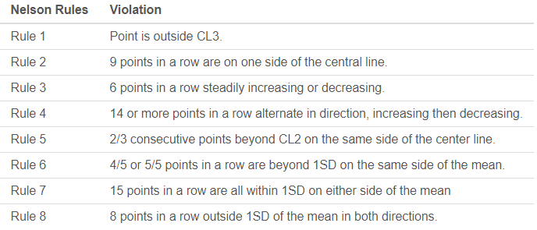

Slide 37
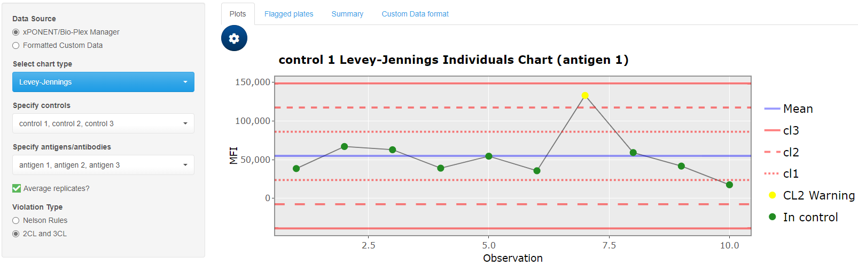

Slide 38
Change which plot is displayed here

Slide 39
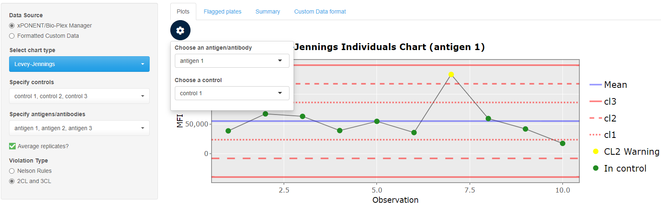

Slide 40
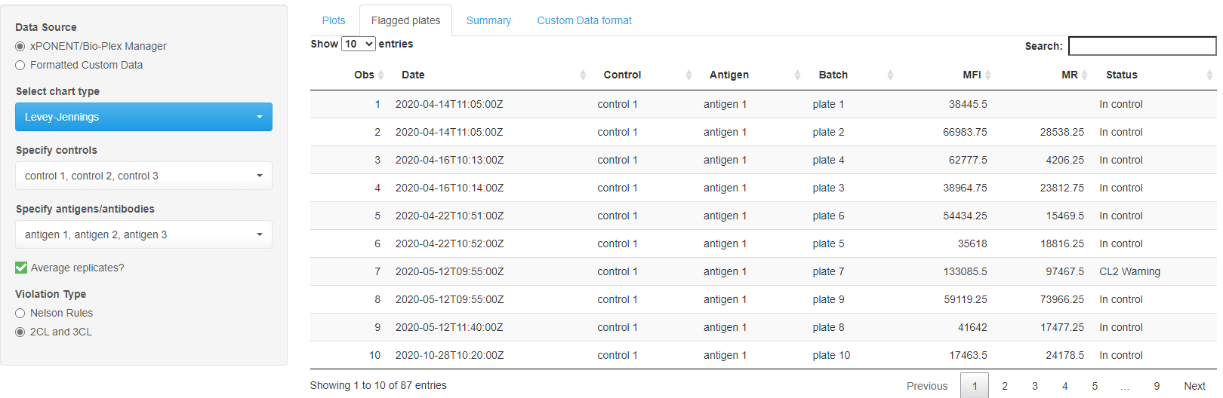
“Flagged Plates” tab contains a list of out of control data points
Shows out of control points for every antigen/antibody

Slide 41
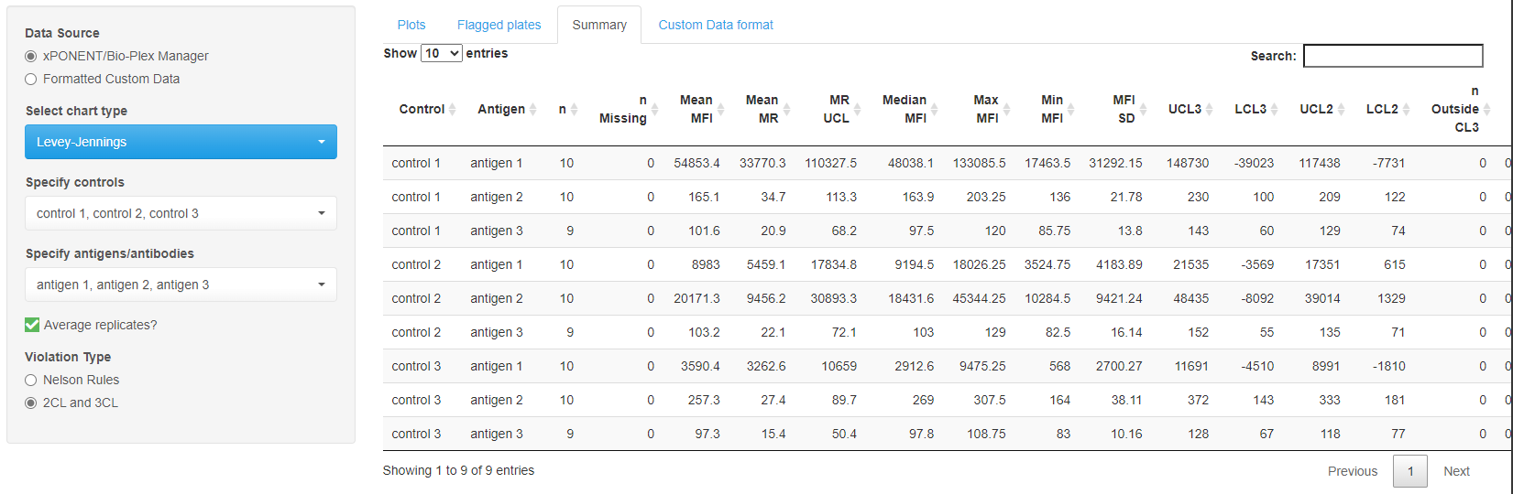
“Summary” tab contains a descriptive statistical summary table for every control and antigen/antibody combination

Slide 42
Control Tracking Module
Custom data source

Slide 43

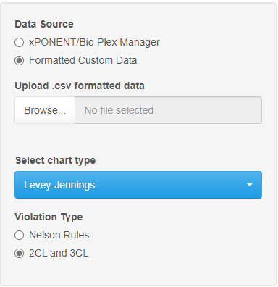
Control Tracking: Custom Data
Click the “Control Tracking” tab
Under “Data Source” select “Formatted Custom Data”

Slide 44
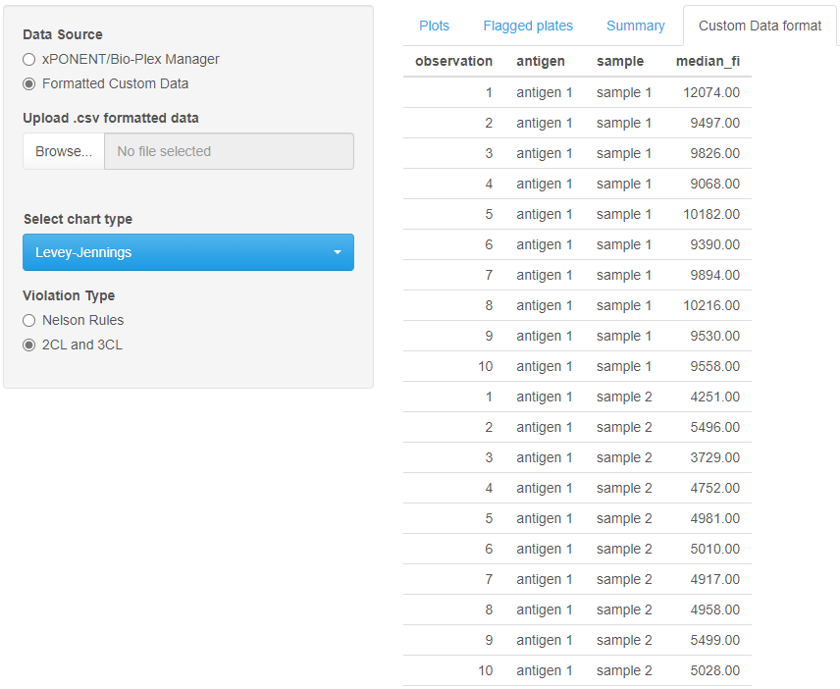
Control Tracking: Custom Data
Click the “Control Tracking” tab
Under “Data Source” select “Formatted Custom Data”
Ensure that your data is formatted correctly
An example of the proper format can be viewed under the “Custom Data format” tab.
Must be a four column .csv with variable names in the first row

Slide 45
Downloadable template

Slide 46

Control Tracking: Custom Data
Click the “Control Tracking” tab
Under “Data Source” select “Formatted Custom Data”
Ensure that your data is formatted correctly
An example of the proper format can be viewed under the “Custom Data format” tab.
Must be a four column .csv with variable names in the first row
Click “Browse…” to open the file explorer

Slide 47
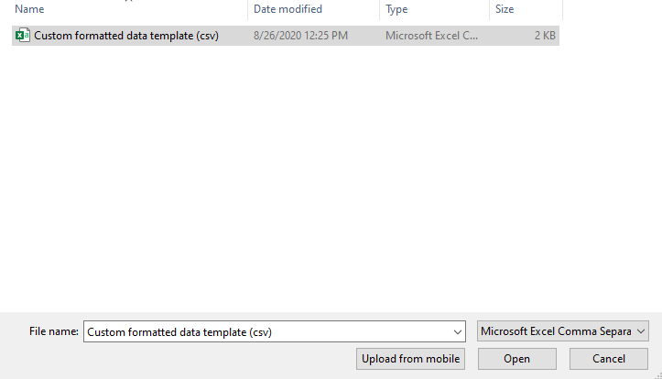
Control Tracking: Custom Data
Click the “Control Tracking” tab
Under “Data Source” select “Formatted Custom Data”
Ensure that your data is formatted correctly
An example of the proper format can be viewed under the “Custom Data format” tab.
Must be a four column .csv with variable names in the first row
Click “Browse…” to open the file explorer
Select your custom formatted .csv file and click “Open”

Slide 48
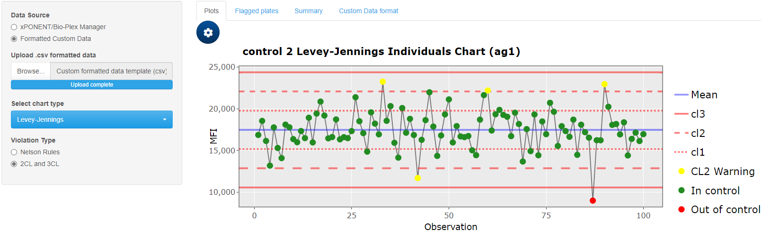
Same features are available for both xPONENT/BPM and custom formatted data.

Slide 49
Downloading Output

Slide 50
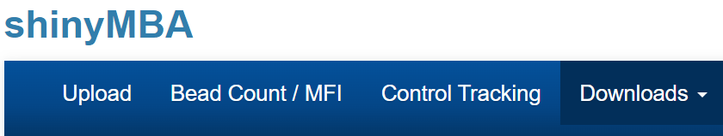
Make sure you have set all the parameters in the “Bead Count/MFI” and “Control Tracking” modules before downloading anything!

Slide 51

Downloading Output
Click the “Downloads” tab

Slide 52

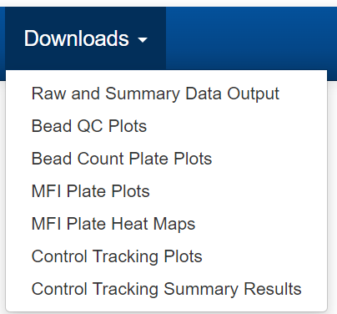
Downloading Output
Click the “Downloads” tab
From the drop-down menu, select which output you want to download

Slide 53
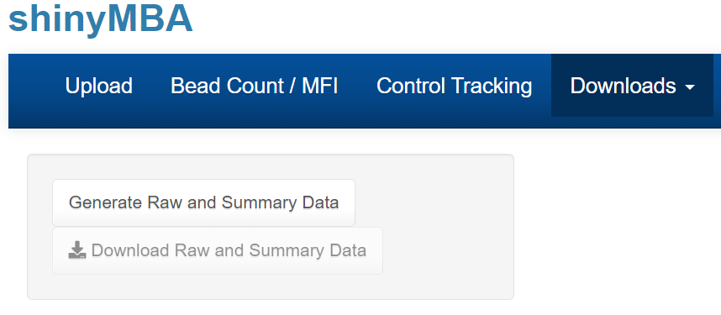
Downloading Output
Click the “Downloads” tab
From the drop-down menu, select which output you want to download.
Click the “generate” button to initiate the download

Slide 54
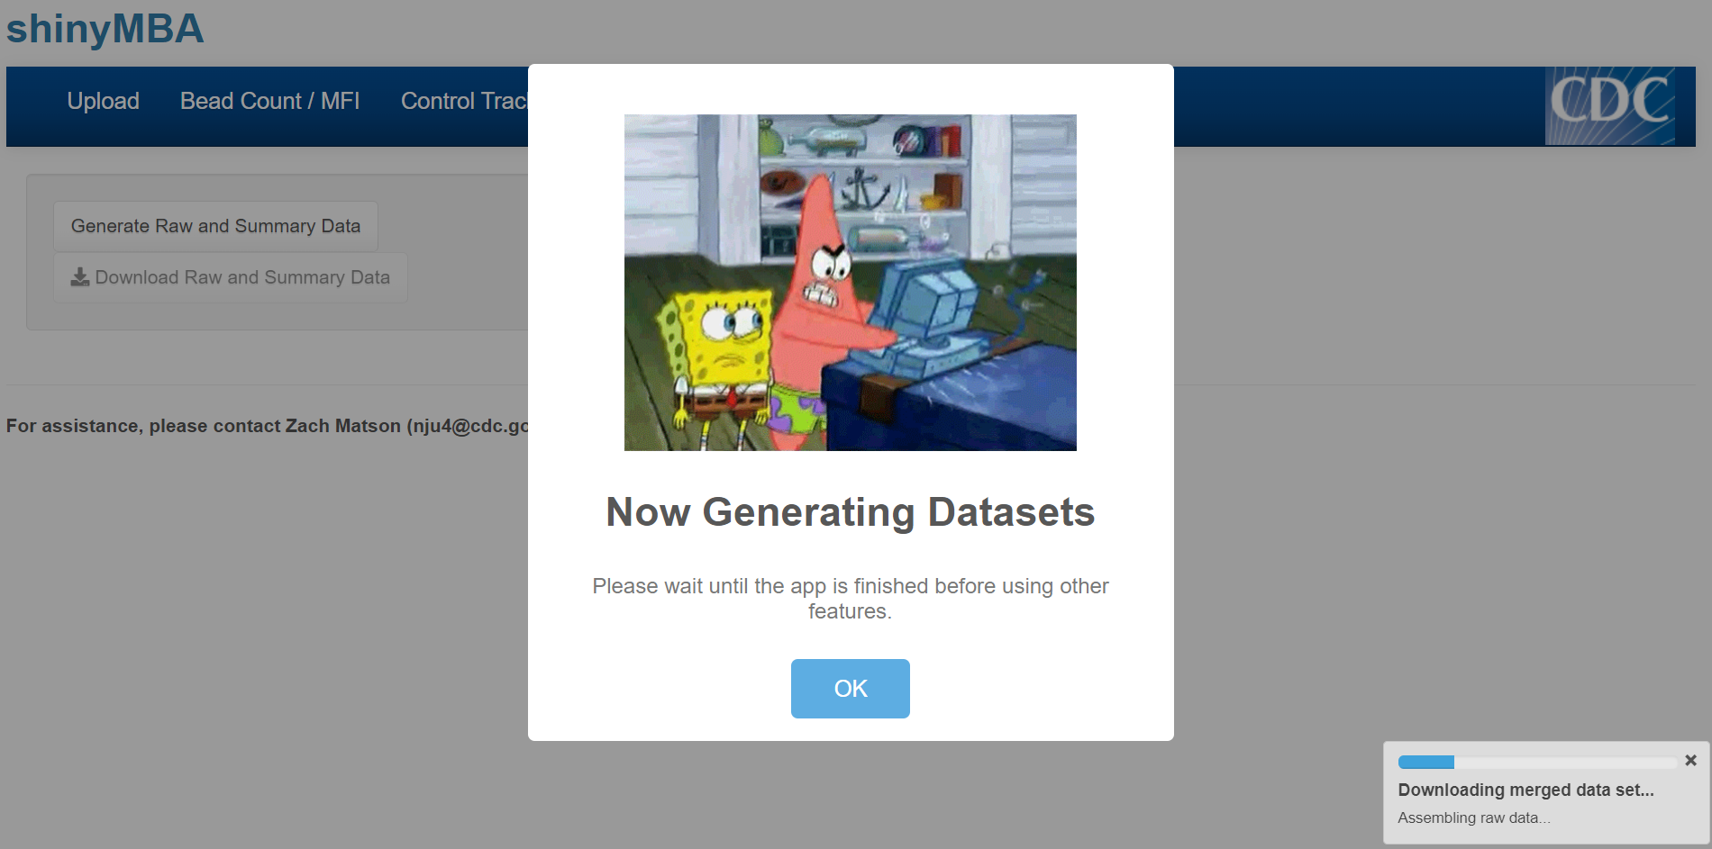
Downloading Output
Click the “Downloads” tab
From the drop-down menu, select which output you want to download.
Click the “generate” button to initiate the download
A window and progress bar will appear. Wait until a confirmation window appears before using other part of the app.

Slide 55
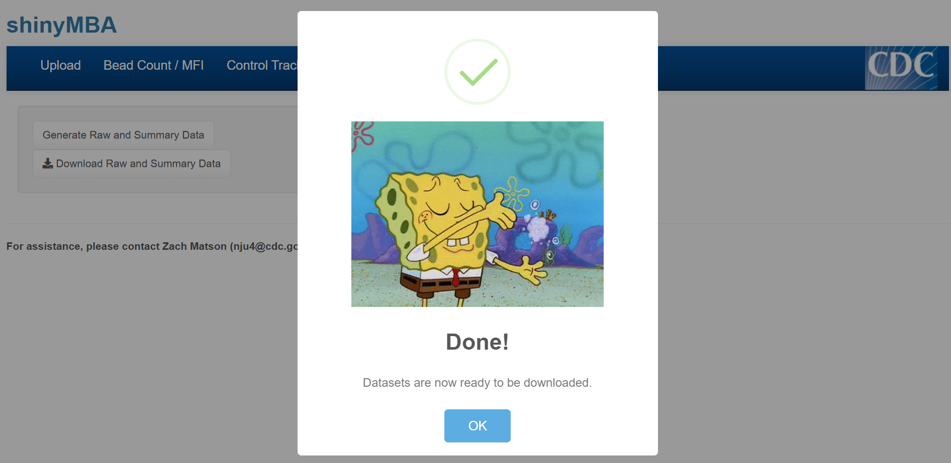
Downloading Output
Click the “Downloads” tab
From the drop-down menu, select which output you want to download.
Click the “generate” button to initiate the download
A window and progress bar will appear. Wait until a confirmation window appears before using other part of the app.

Slide 56
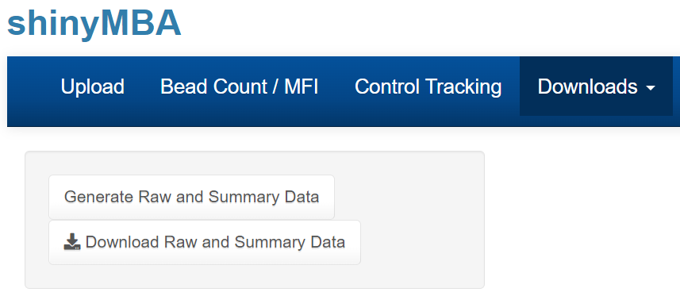
Downloading Output
Click the “Downloads” tab
From the drop-down menu, select which output you want to download.
Click the “generate” button to initiate the download
A window and progress bar will appear. Wait until a confirmation window appears before using other part of the app.
Click the “download” button to save the output

Slide 57
Types of Downloadable Output

Slide 58
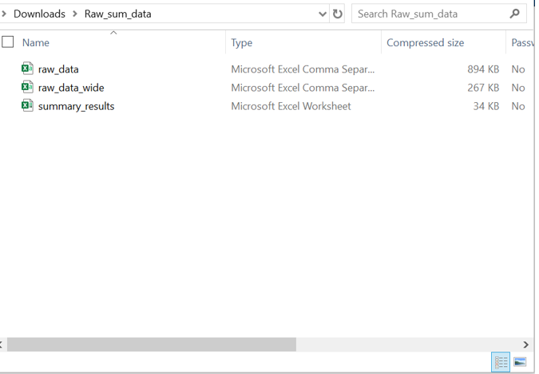
Merged datasets and bead count QC summary tables

Slide 59
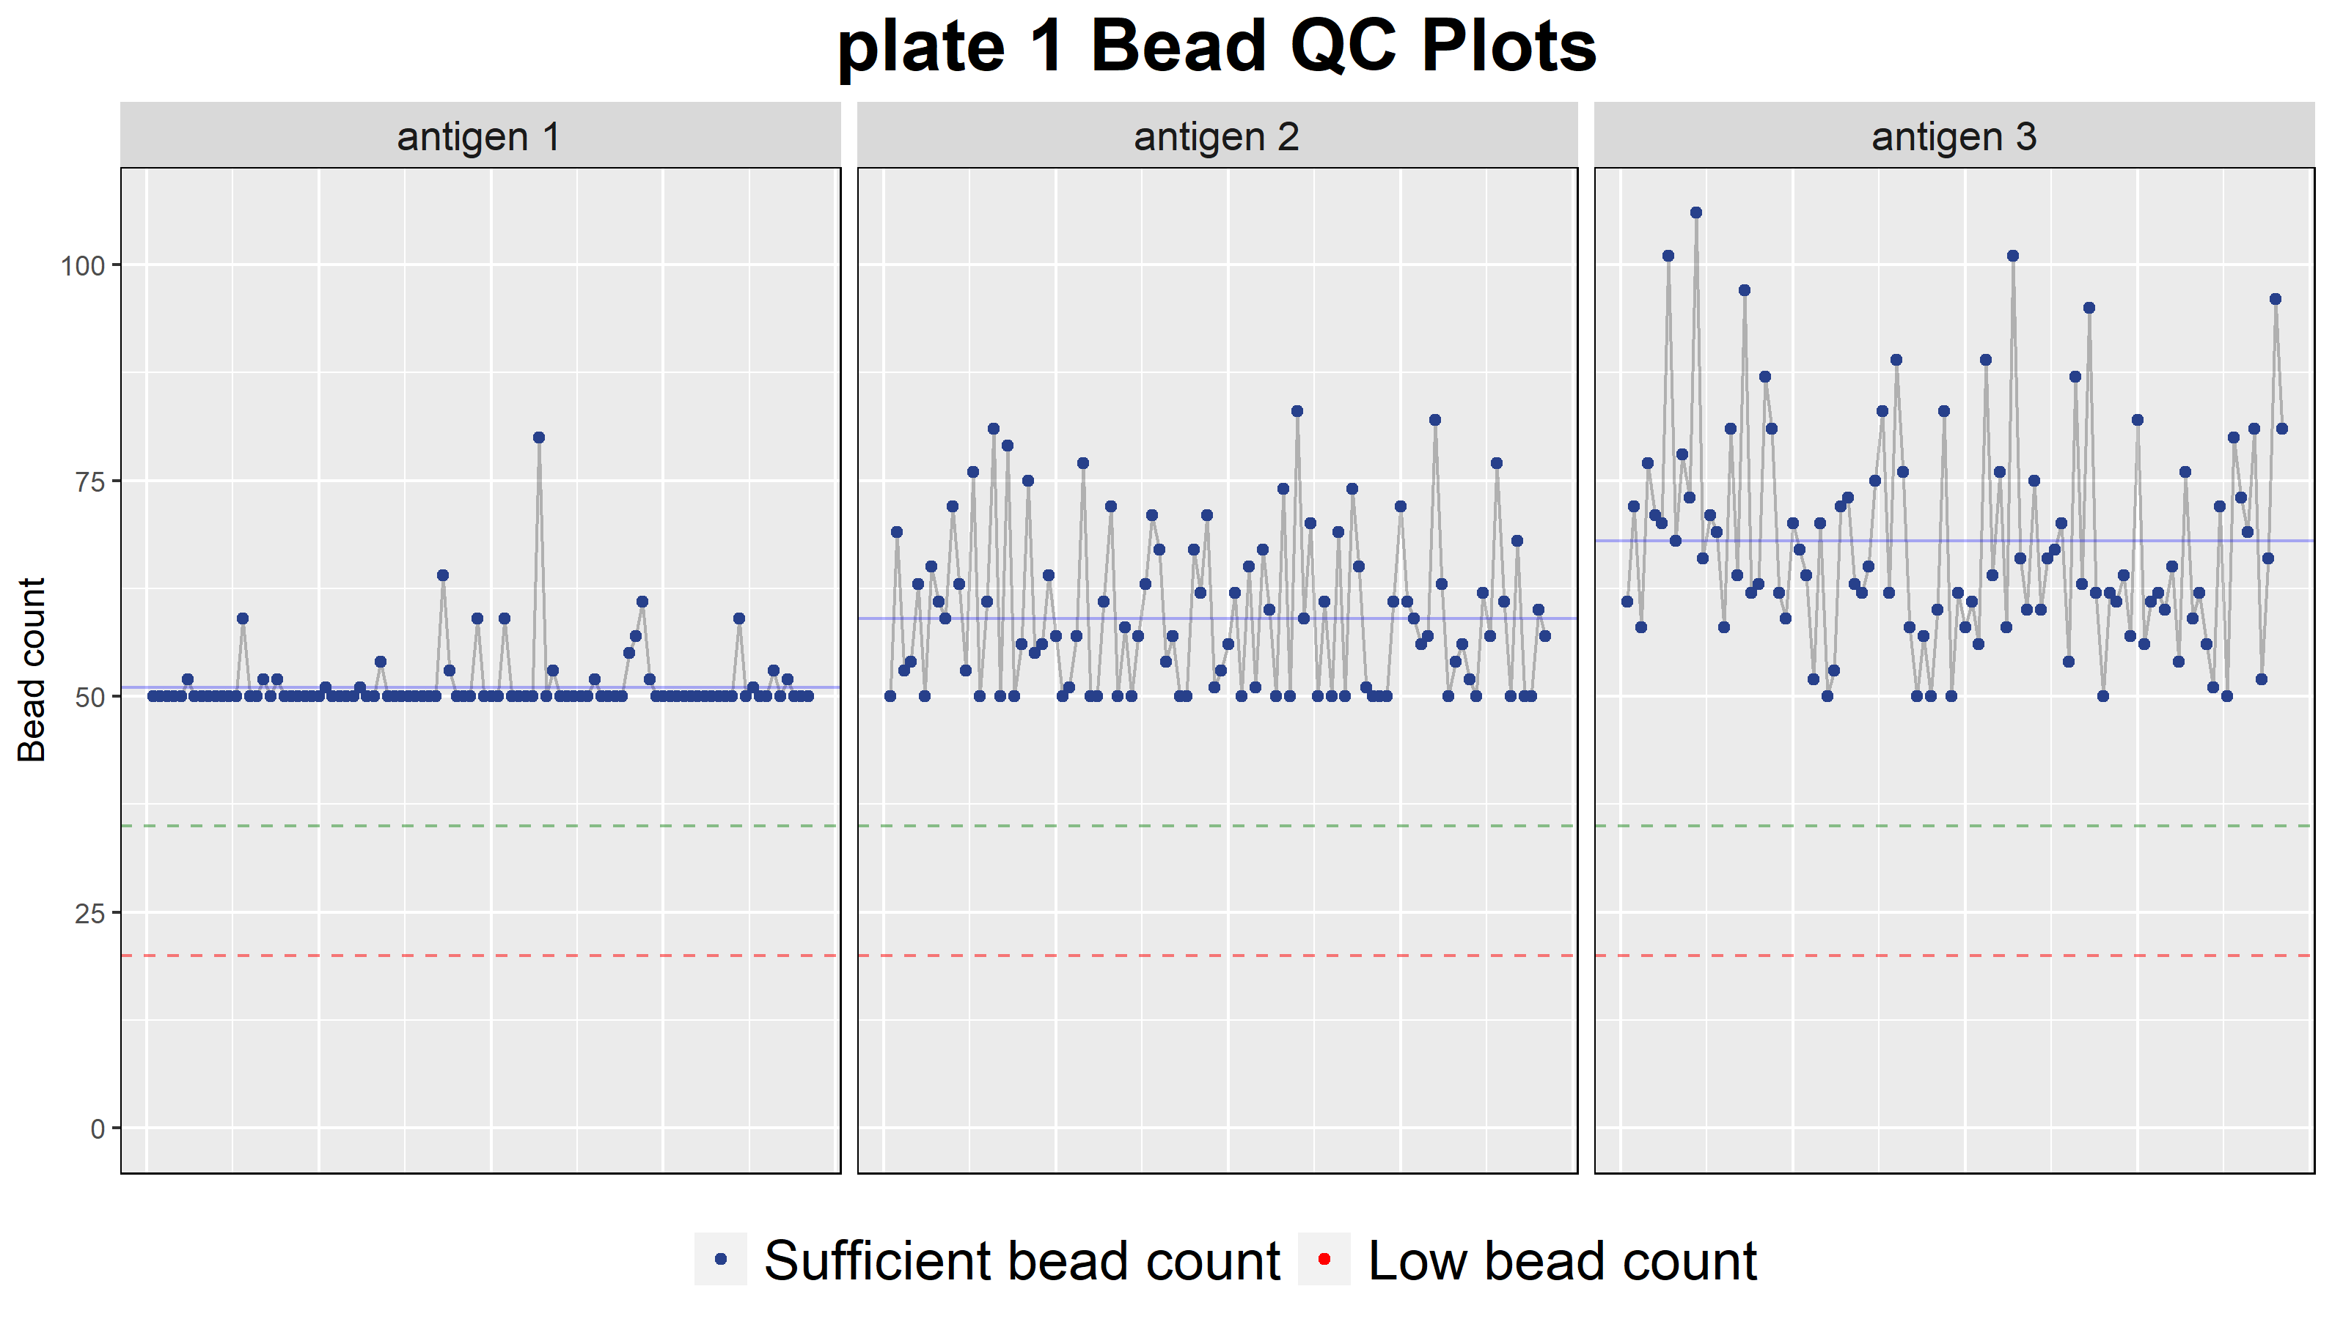
Bead count fluctuation plots
One plot for each plate with facets for every antigen/antibody

Slide 60
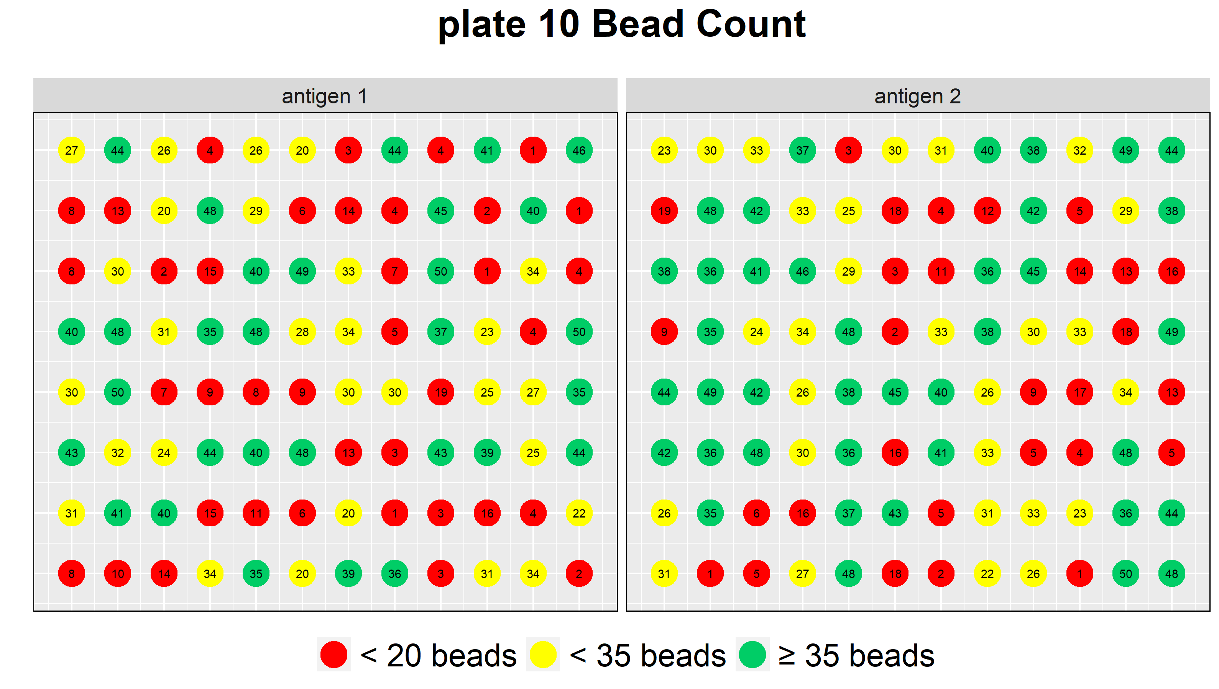
Bead count 96-well plate plots
One plot for each plate with facets for every antigen/antibody

Slide 61
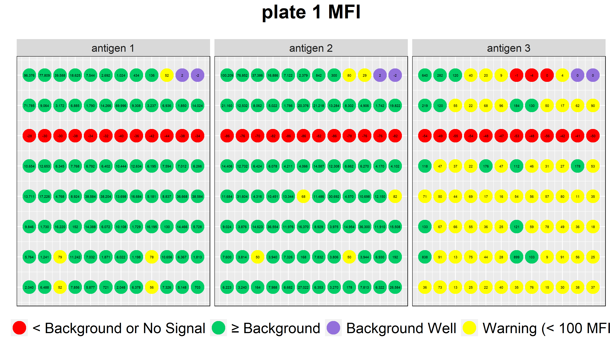
MFI 96-well plate plots
One plot for each plate with facets for every antigen/antibody

Slide 62
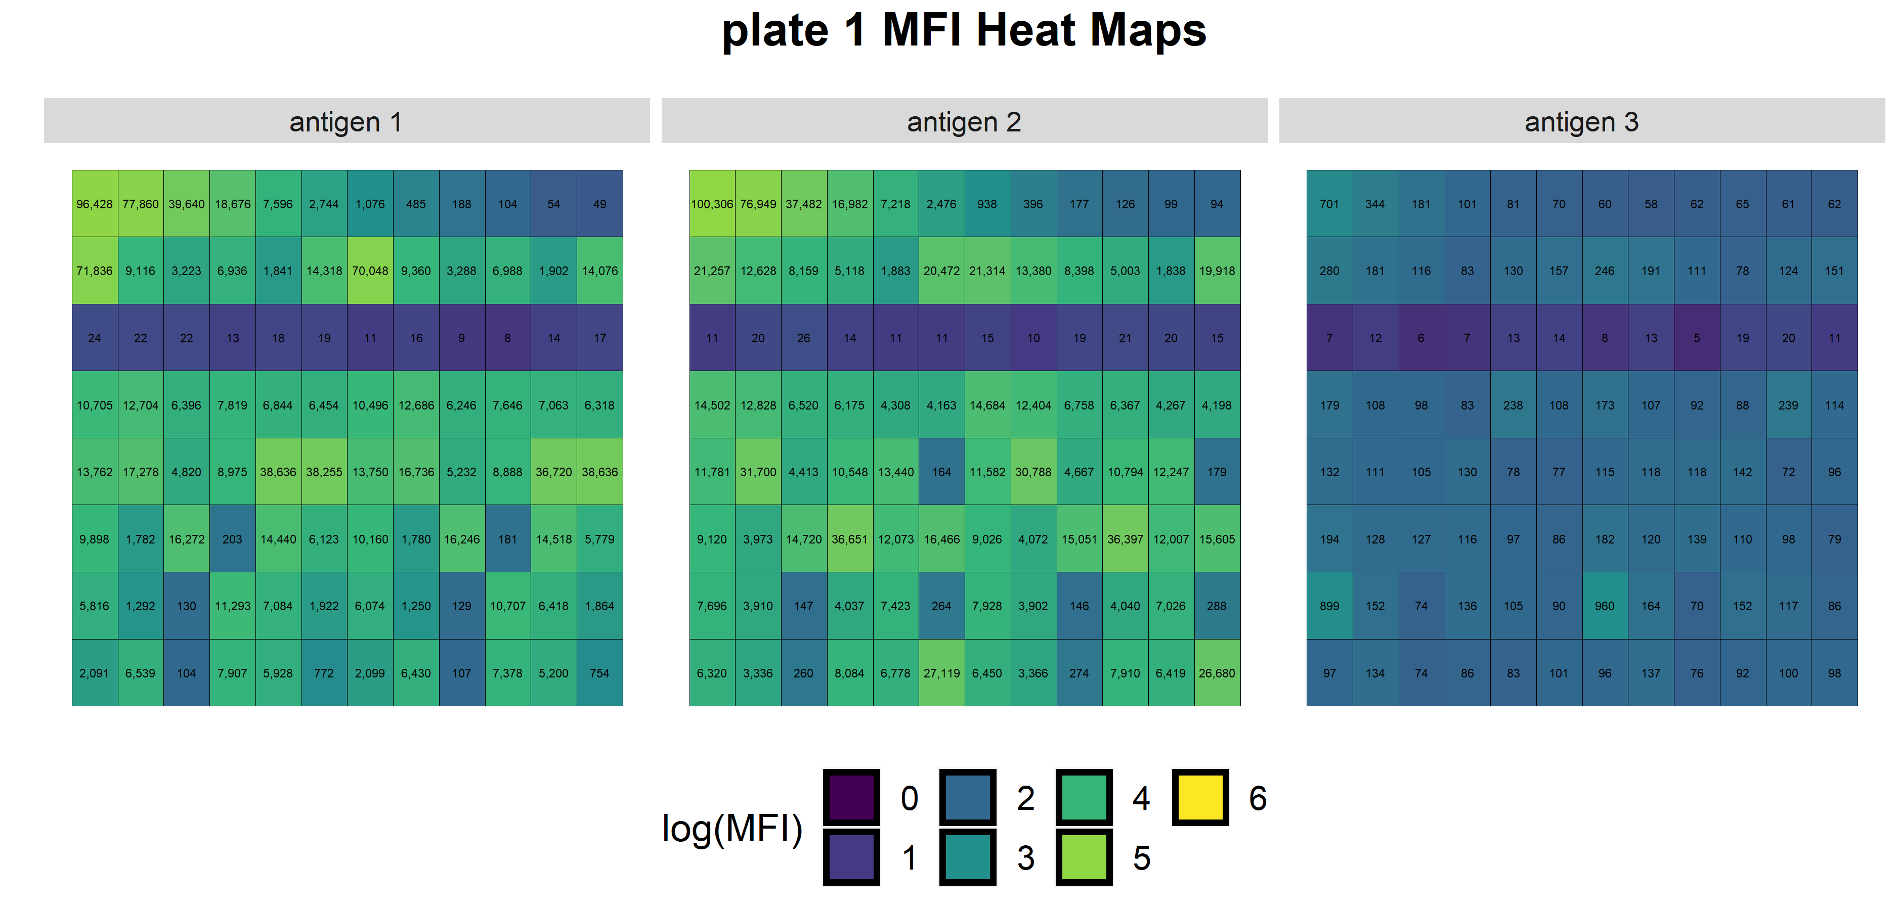
Log(MFI) 96-well heat maps
One plot for each plate with facets for every antigen/antibody

Slide 63
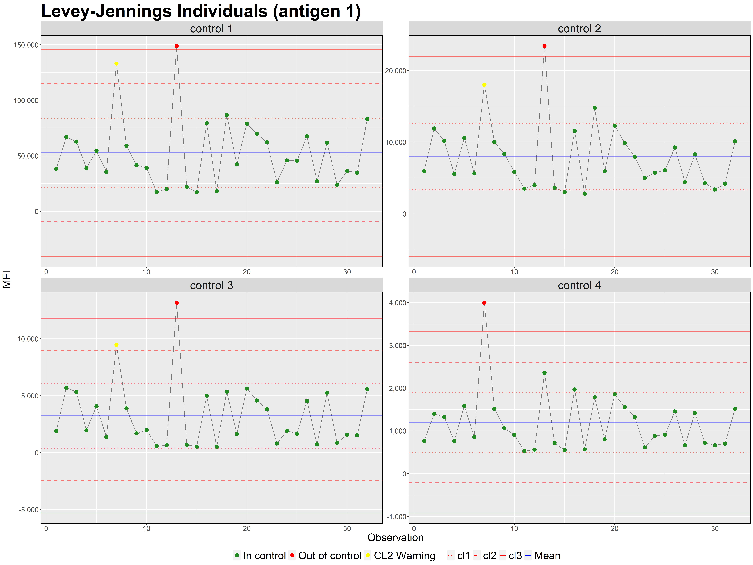
Control Process charts
One plot for each antigen/antibody with facets for every control

Slide 64
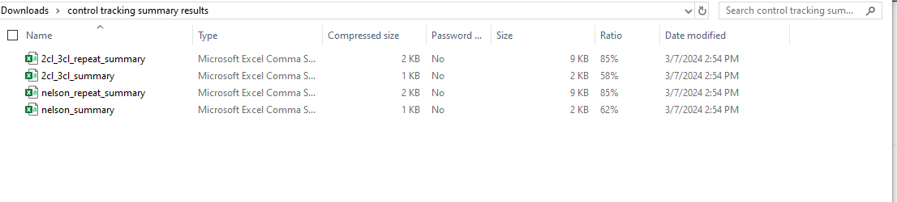
Levey-Jennings summary tables
Contains both Nelson rules and 2CL-3CL results

